Slide 1
Web Technologies
Almaz Turginbekov
MSc in Computer Science and Engineering
Graduate School of Science and Technology
Niigata University
Teacher East-Kazakhstan Technical University

Slide 2
Recap Week 1
HTML (HyperText Markup Language): The skeleton of the web.
Structure: We learned the basic boilerplate (<html>, <head>, <body>).
Tags: We covered headings (<h1>-<h6>), paragraphs (<p>), links (<a>), and images (<img>).
Today's Goal: Finish core HTML elements (Lists, Tables, Forms) and introduce CSS.

Slide 3
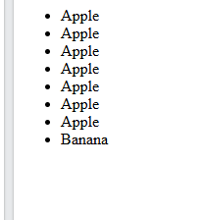
HTML Lists (Ordered & Unordered)
Lists are essential for grouping related items.
Unordered List (<ul>): Bullet points.
List Item (<li>): Used inside the list.
Ordered List (<ol>): Numbered points (1, 2, 3...).
<ul>
<li>Apple</li>
<li>Banana</li>
</ul>

Slide 4
HTML Tables
Tables are used to display tabular data (like spreadsheets).
Main Tags:
  <table>: The container for the table.
  <tr> (Table Row): Defines a single row.
  <th> (Table Header): A header cell (usually bold and centered).
  <td> (Table Data): A standard data cell.

Slide 5
Semantic Table Sections
For large tables, it is best practice to divide them into semantic sections. This helps screen readers and makes styling (later) much easier.
  <thead>: Groups the header content.
  <tbody>: Groups the main body content.
  <tfoot>: Groups the footer content (e.g., totals, summaries).

Slide 6
Advanced Tables (Merging Cells)
Sometimes you need a cell to span across multiple columns or rows.
colspan attribute: Merges cells horizontally (across columns).
  <th colspan="2"> (This cell takes the space of 2 columns).
rowspan attribute: Merges cells vertically (across rows).
  <td rowspan="3"> (This cell takes the space of 3 rows).
Semantic Table Tags: For complex tables, it's best practice to group rows into sections:
  <thead>: Table Header (contains headers).
  <tbody>: Table Body (contains main data).
  <tfoot>: Table Footer (contains summaries/totals).

Slide 7
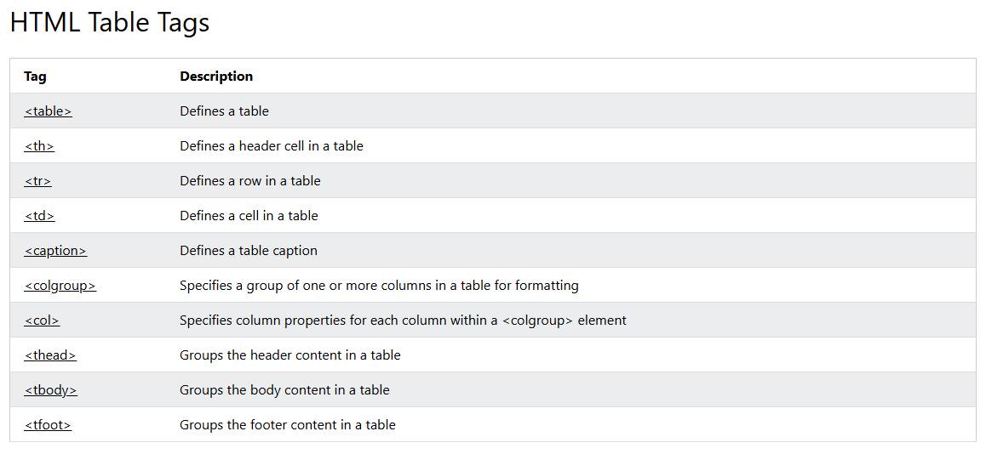
HTML Tables
Tables are used to display tabular data (like spreadsheets).
Main Tags:
  <table>: The container for the table.
  <tr> (Table Row): Defines a single row.
  <th> (Table Header): A header cell (usually bold and centered).
  <td> (Table Data): A standard data cell.

Slide 8
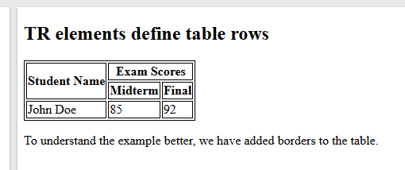
  <table border="1">
  <thead>
  <tr>
  <th rowspan="2">Student Name</th>
  <th colspan="2">Exam Scores</th>
  </tr>
  <tr>
  <th>Midterm</th>
  <th>Final</th>
  </tr>
  </thead>
  <tbody>
  <tr>
  <td>John Doe</td>
  <td>85</td>
  <td>92</td>
  </tr>
  </tbody>
  </table>

Slide 9
HTML Forms
Forms are the primary way to collect user data (Login, Registration, Search).
<form> tag: The main container.
Key Attributes:
  action="URL": Where to send the form data when submitted.
  method="GET|POST": How to send the data. (GET for search/retrieval, POST for sensitive data like passwords).

Slide 10
Input Types
The most versatile form element. It is an empty, self-closing tag.
The type attribute completely changes how it works:
  type="text": Standard single-line text field.
  type="password": Hides the characters.
  type="email": Auto-validates that the text contains an '@'.
  type="number": Only accepts numbers, adds up/down arrows.

Slide 11
Checkboxes, Radios & Selects
Checkbox: For multiple choices.
  <input type="checkbox"> I agree
Radio Button: For a single choice from a group (they must share the same name attribute).
  <input type="radio" name="gender"> Male
  <input type="radio" name="gender"> Female
Dropdown (<select>):
  Uses <option> tags inside for the choices.

Slide 12
TextArea and Buttons
<textarea>: For multi-line text input (like comments or messages).
Buttons: How users trigger actions.
  <button type="submit">Send</button>: Submits the form data.
  <button type="reset">Clear</button>: Clears all inputs in the form.

Slide 13
Label
Labels provide descriptions for form elements.
Why use it? If you click a properly linked label, it automatically activates the input field (great for tiny checkboxes!).
How to link: The for attribute of the label MUST match the id attribute of the input.
  <label for="user-email">Email:</label>
  <input type="email" id="user-email" name="email">

Slide 14
Multimedia: Audio & Video
HTML5 introduced native tags to embed media without plugins (like Flash).
<audio>:
  <audio src="music.mp3" controls></audio>
<video>:
  <video src="movie.mp4" width="500" controls></video>
The controls attribute adds the play/pause buttons and volume slider.

Slide 15
Iframes
<iframe>: Used to display a web page within a web page.
Very commonly used to embed YouTube videos or Google Maps interactively.
Example:
HTML
<iframe src="https://www.google.com/maps/..." width="600" height="450"></iframe>

Slide 16
HTML Entities (Special Characters)
Some characters are reserved in HTML (like < and >). If you want to display them as text, you must use entities.
Common entities:
  &lt; = < (Less than)
  &gt; = > (Greater than)
  &amp; = & (Ampersand)
  &copy; = © (Copyright symbol)
  &nbsp; = Non-breaking space (forces a space that won't collapse).

Slide 17
Semantic HTML (Divs vs. Meaning)
In the past, developers used <div> (a generic container) for everything. This made code hard to read and bad for search engines.
Semantic Tags clearly describe their meaning to both the browser and the developer.
Using semantic tags improves SEO (Search Engine Optimization) and Accessibility for screen readers.

Slide 18
Key Semantic Layout Tags
<header>: Introductory content or navigation links.
<nav>: Main navigation menu.
<main>: The dominant content of the body.
<article>: Independent, self-contained content (a blog post, news story).
<section>: A thematic grouping of content, usually with a heading.
<footer>: Footer for its nearest section or the whole page (copyrights, links).

